Slide 1
Individual Pig Tracking and Behavior Monitoring with Deep Learning
Jake Cowton, Dr. Jaume Bacardit & Prof. Ilias Kyriazakis 27/08/19

Slide 2
Overview
Transition away from pen-level treatment to individual-level
Developed a system to localise & track individual pigs
Without marking or tagging the pigs
Extract behavioural metrics from individual pig tracks
Use for individual-level assessment & treatment

Slide 3
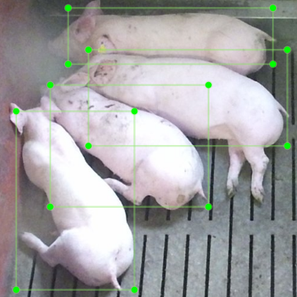
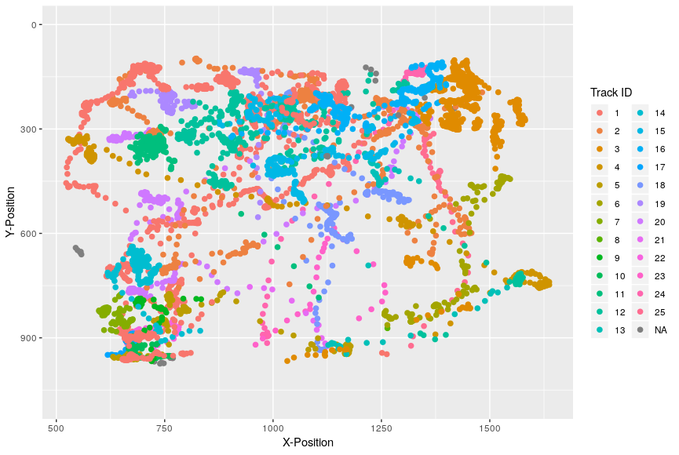
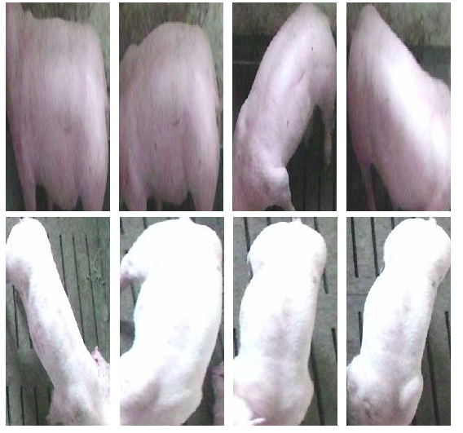
Datasets
Pig Detection
Pig Tracking
Pig Re-ID
Bounding boxes of pigs in images
Location of individual pigs across a video
Sets of images of the same pig
1,646 images
9,014 annotations
25 pig tracks
7.8 minute video @ 4 FPS
1,874 frames
25 pig identities
5,653 total images
Resized to 128 x 256
Notes:
We also used ImageNet & Pascal VOC 2007 in detection and MARS in re-identification

Slide 4
Implementation
Faster R-CNN
Deep SORT
Behavioural Metric Extraction
An object detection method for localising and classifying objects within in an image Uses the Pig Detection dataset
Uses the trajectory and visual appearance of detected objects to track each of them between frames Uses the Pig Tracking & Re-ID datasets
Using the tracks from Deep SORT we extracted metrics about each pig’s activity: distance travelled, average speed, time spent idle Uses metrics extracted from the Pig Tracking dataset

Slide 5
Full Workflow
Label Training Data
Faster R-CNN
Deep SORT
Apply to Test Dataset
Extract Behaviours from tracks
• Draw regions of interest around each pig • Assign an ID to each pig
• Faster R-CNN pretrained on ImageNet, then trained on Pascal VOC 2007 datasets
• Faster R-CNN trained on pig detection dataset using transfer learning
• Deep SORT trained to re-identify humans using visual appearance (MARS dataset)
• Deep SORT trained to re-identify pigs based on visual appearance using Pig Re-ID dataset
• Faster R-CNN & Deep SORT are applied to the Pig Tracking dataset
• Individual behaviour metrics are extracted from the tracks
• These are evaluated against the ground truth tracks

Slide 6
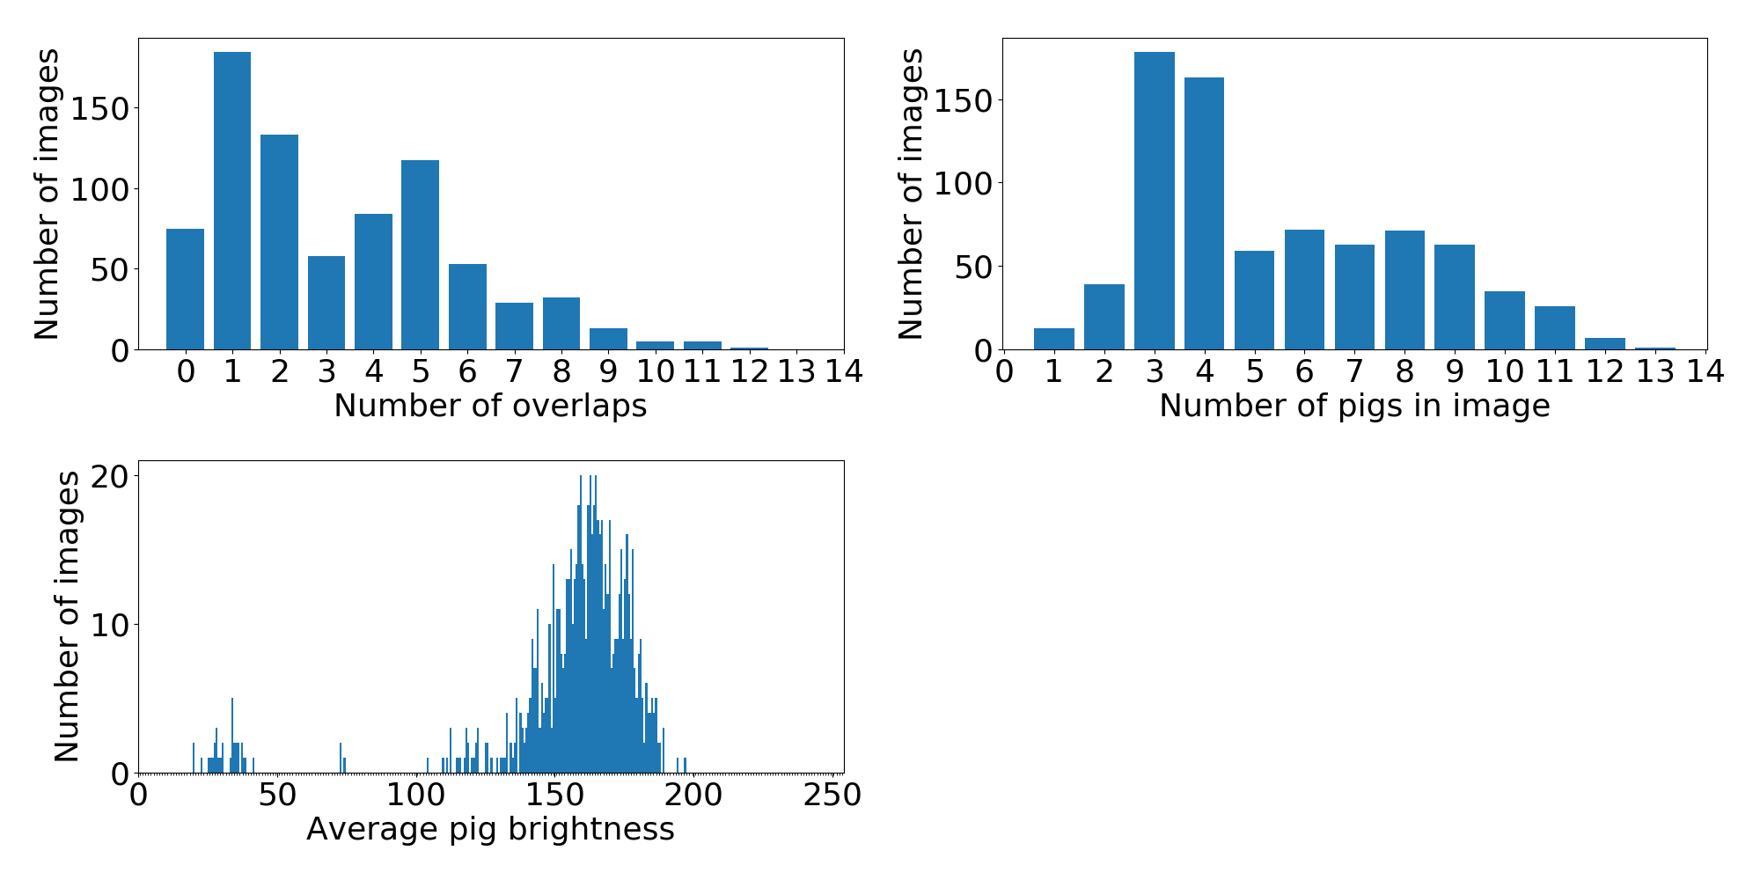
Results - Detection
Overall
0.901 mAP Many pigs >10 pigs in image
0.905 mAP
Densely packed 4 or more overlapping pigs
0.906 mAP
Overexposed Bright sunlight distorts the image
(manually selected)
0.906 mAP
Low-light Average pig brightness < 100
0.850 mAP
Notes:
The detection test set was broken down into 4 subsections in order to better evaluate the performance under different conditions Many pigs = more than 10 pigs in the image (4% of test set)
Densely packed pigs = 4 or more overlapping bounding boxes (43% of test set)
Overexposed images = where sunlight distorts the image [manually selected] (11% of test set)
Low-light = Average pig brightness in an image

Slide 7
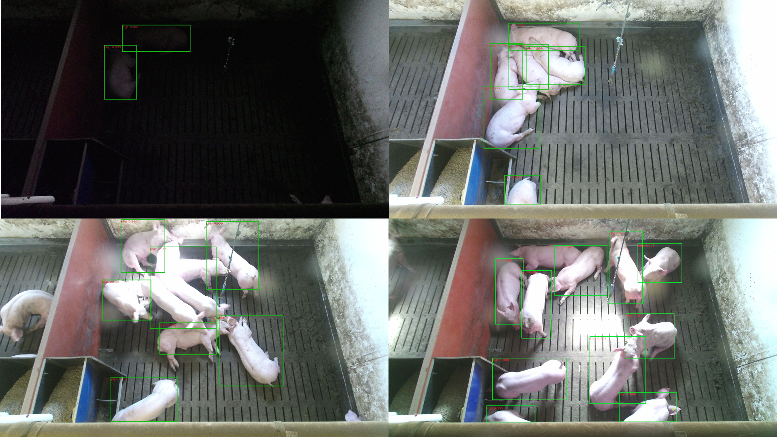
Results - Detection
Notes:
Top-bottom, left-right:
Low-light
Densely packed
Overexposed
Many pigs

Slide 8

Results - Tracking
MOTA 0.95
How well we track multiple pigs
IDF1 0.73
How well we retain IDs of individual pigs

Slide 9
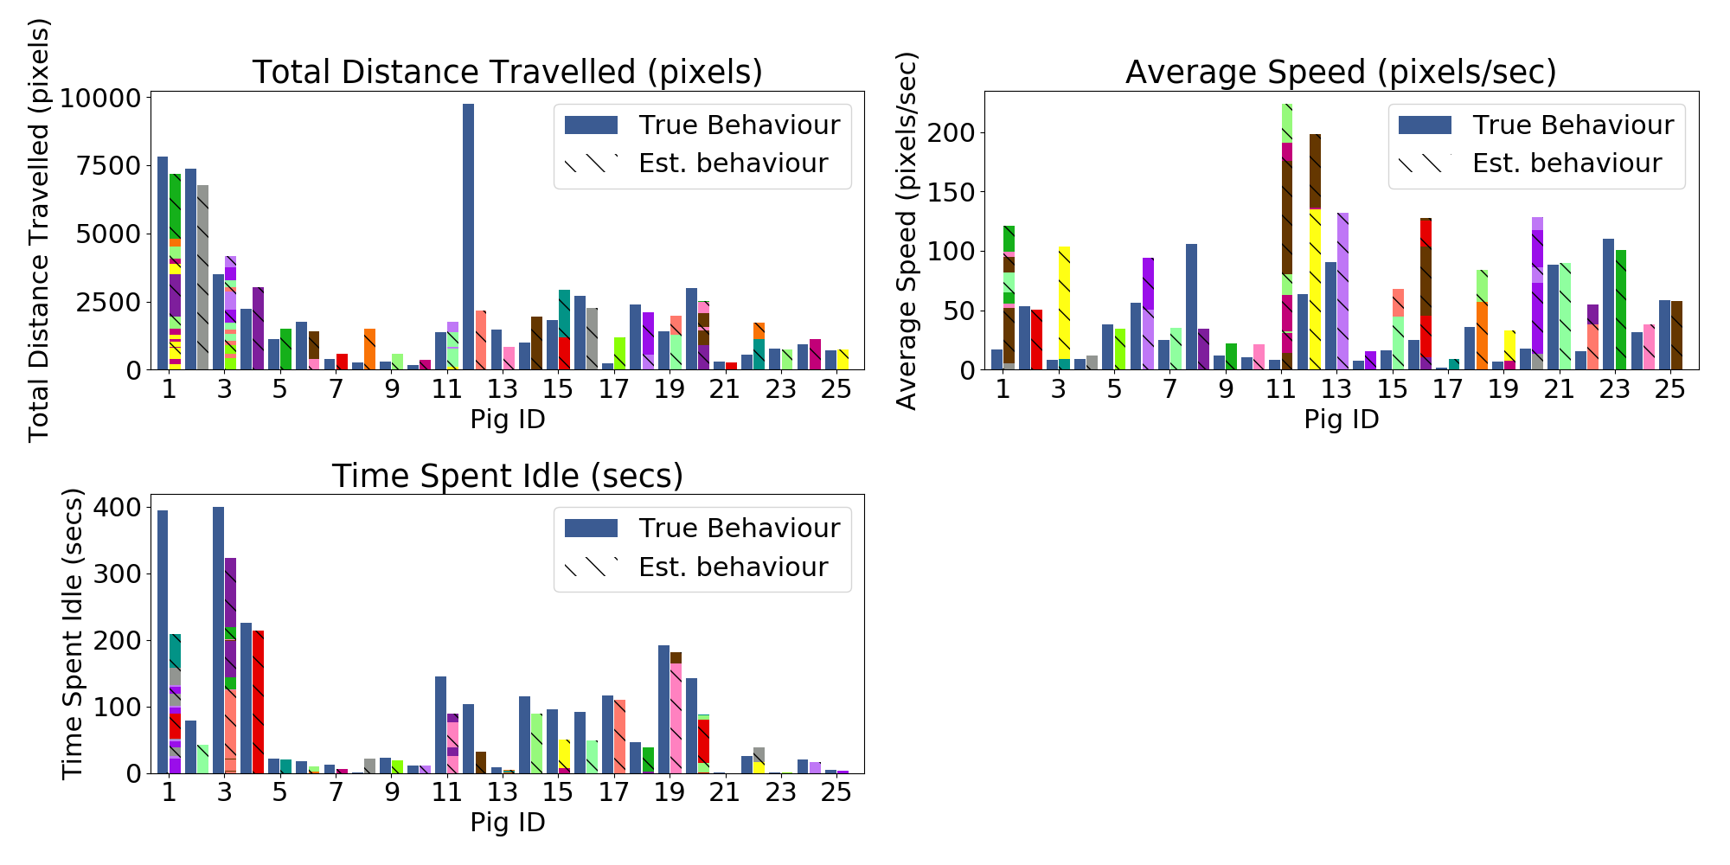
Results - Behaviour Extraction
Total Distance Travelled 0.015 MSE
Time Spent Idle 0.008 MSE
Average Speed 0.008 MSE

Slide 10
Summary
Moving away from pen-level to pig-level treatment and care
We are able to detect pigs in very challenging scenarios
Tracking of pigs is enabled through trajectory & visual-based metrics
We can use tracks to extract accurate behavioural metrics

Slide 11
Individual Pig Tracking and Behaviour Monitoring with Deep Learning
Jake Cowton, Dr. Jaume Bacardit & Prof. Ilias Kyriazakis 27/08/19

